Slide 1
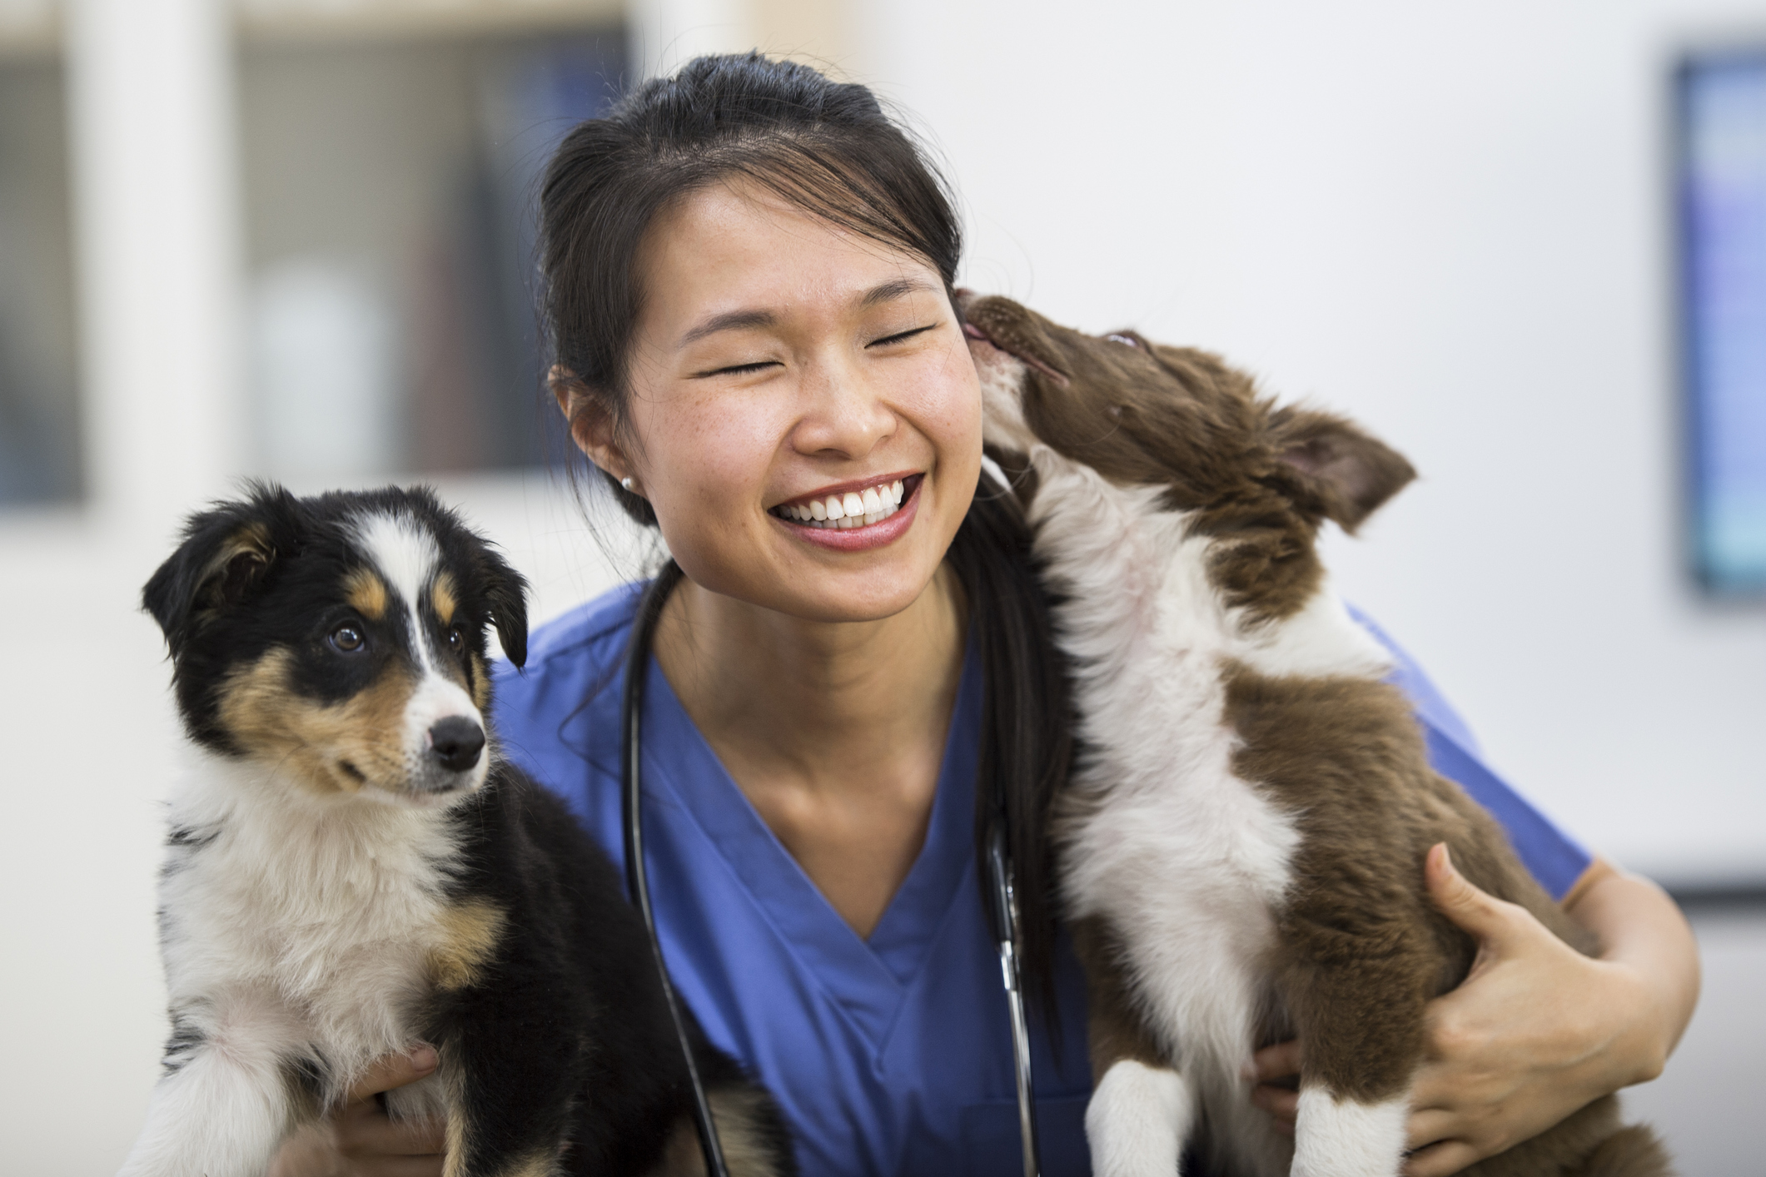
Shelly Pet Hospital & Wellness Center
Quality Care for Pets and Their Families

Slide 2
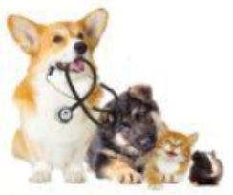

Our Service
Emergency Care
X-rays and laboratory testing
Preventive Care
Routine checkups and vaccinations
One-third of dogs and cats are overweight

Slide 3
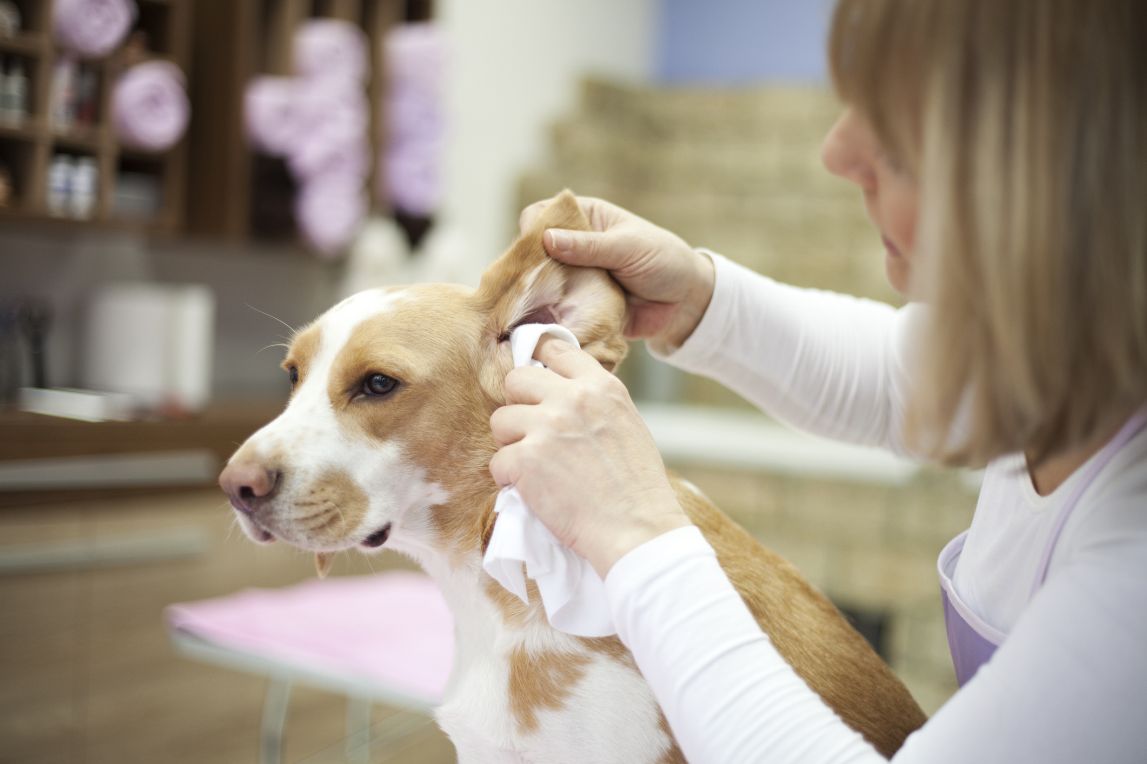
Grooming Facilities
Notes:
We offer quality dog and cat grooming services performed by our experienced pet stylist. We will pamper your pet with a bath, nail trimming, and ear cleaning. Services vary in price based on the animal’s breed and size.

Slide 4
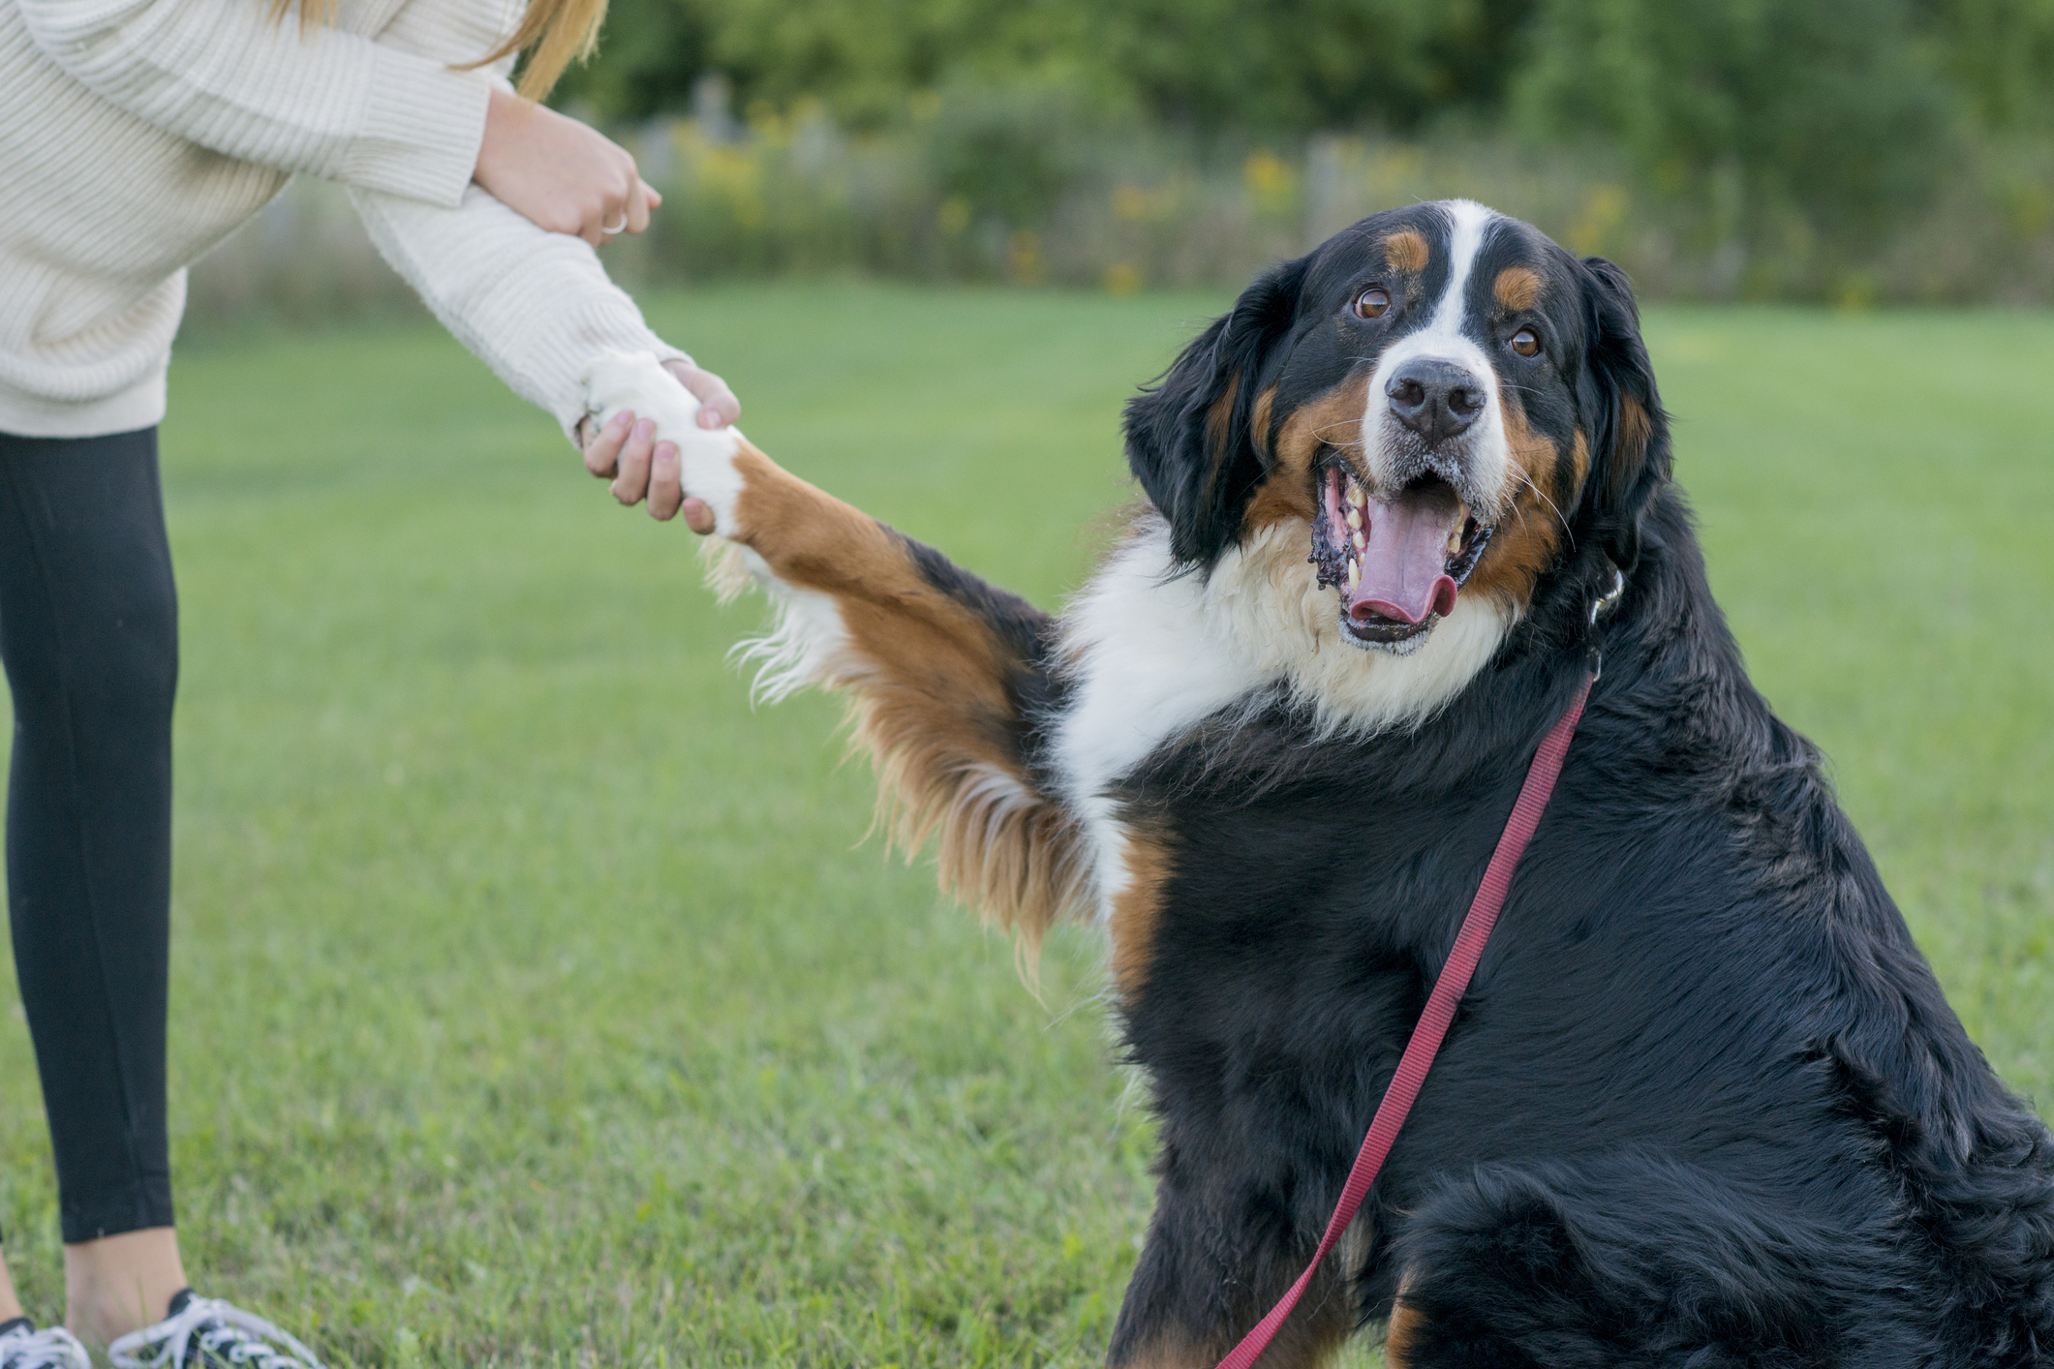

Obedience Classes
Basic and Advanced Skills
Small Group Sizes
Notes:
Obedience training is fun and rewarding for your dog and for you. Our classes focus on essential commands and socialization.

